Slide 1

Bridging markets, EU trade and visa policies’ impact on business events
Moderator: Barbara Weizsäcker
Speakers: Tomislav Tadic - Roland Bleinroth - Jörg Wojahn – Silvia Bauermeister
Notes:
Cover

Slide 2
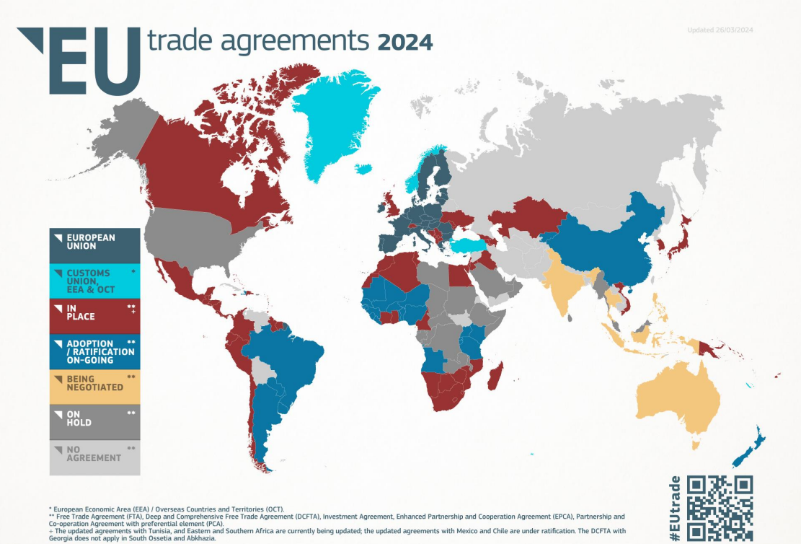
42 preferential trade agreements with
74
partners worldwide

Slide 3
Trade and Services in EU Trade Agreements
The EU is the world’s largest trader of services.
Trade in services accounts for 25% of the EU’s GDP, with services exports exceeding €900 billion per year.
Trade in services supports 21 million EU jobs, directly and indirectly.
Key objectives to ensure that EU service providers:
are allowed to supply services in foreign markets
are not discriminated against compared to national operators or other foreign operators
Convention Services / Trade Fairs / Exhibitions
Negotiated as part of a limited list of sectors with special privileges

Slide 4
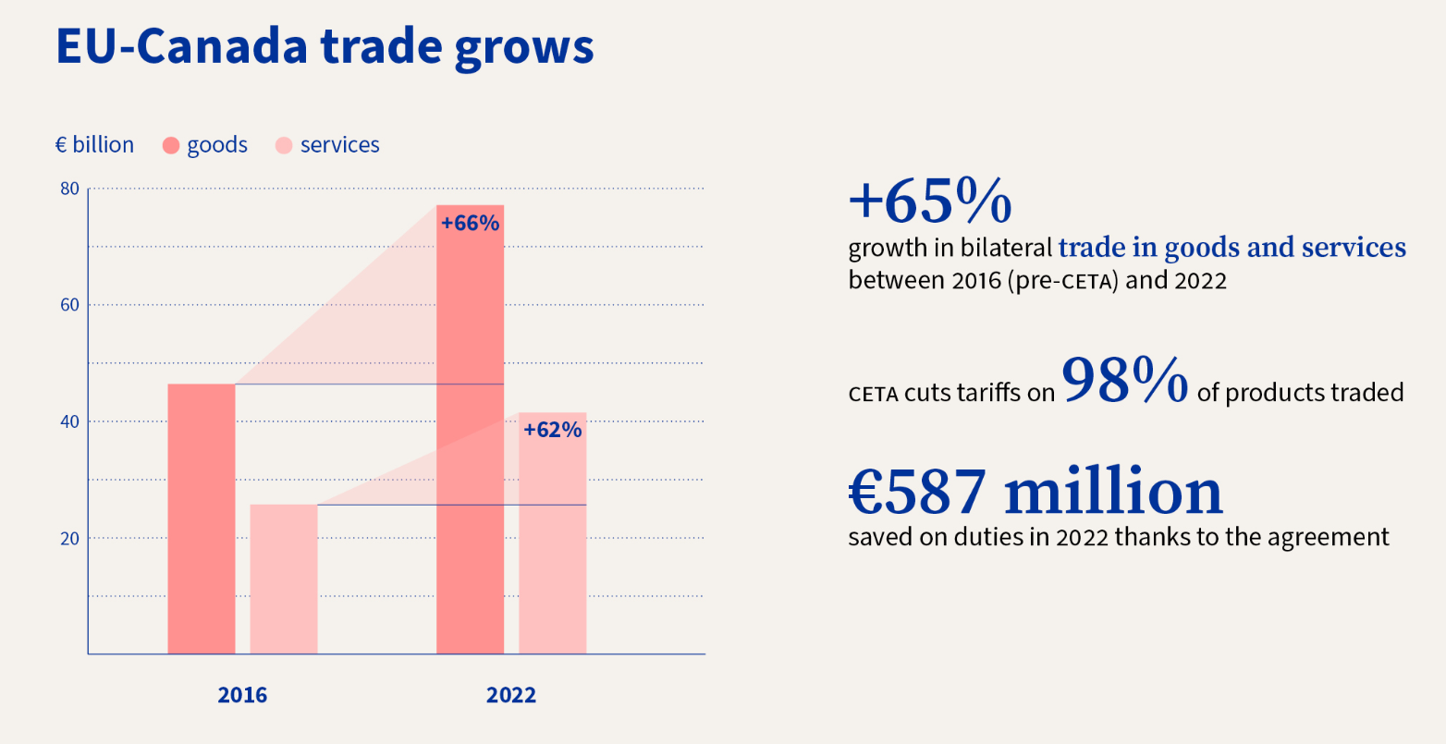
EU-Canada Comprehensive Economic and Trade Agreement (CETA)

Slide 5
trade fairs and international trade
Silvia Bauermeister

Slide 6
99.5 percent of companies see trade fairs as indispensable in the next 5 years.
99%
RELEVANCE
The majority of exhibiting companies (63.8 percent) assume that trade fairs will continue to have the same (59.0 percent) or increasing (4.8 percent) importance for their marketing in the next five years.
…of exhibiting companies do not want to miss out on trade fairs in the future…
Source: AUMA exhibitor outlook 2024/2025. Survey in October/November 2023, n=400 companies.

Slide 7
Biggest trade fair organizers worldwide are based in Europe
Informa UK
RX UK
Messe Frankfurt GER
GL events F
Messe München GER
Koelnmesse GER
MCH Group CH
Clarion UK
Messe Düsseldorf GER
Deutsche Messe GER
Compexposium F
Emerald Expositions USA
Messe Berlin GER
NürnbergMesse GER
Fiera Milano I
HKTDC HK
Hyve Group UK
Fira Barcelona E
NEC Group UK
BolognaFiere I
Source: AUMA, ranking by revenue as of 2019

Slide 8
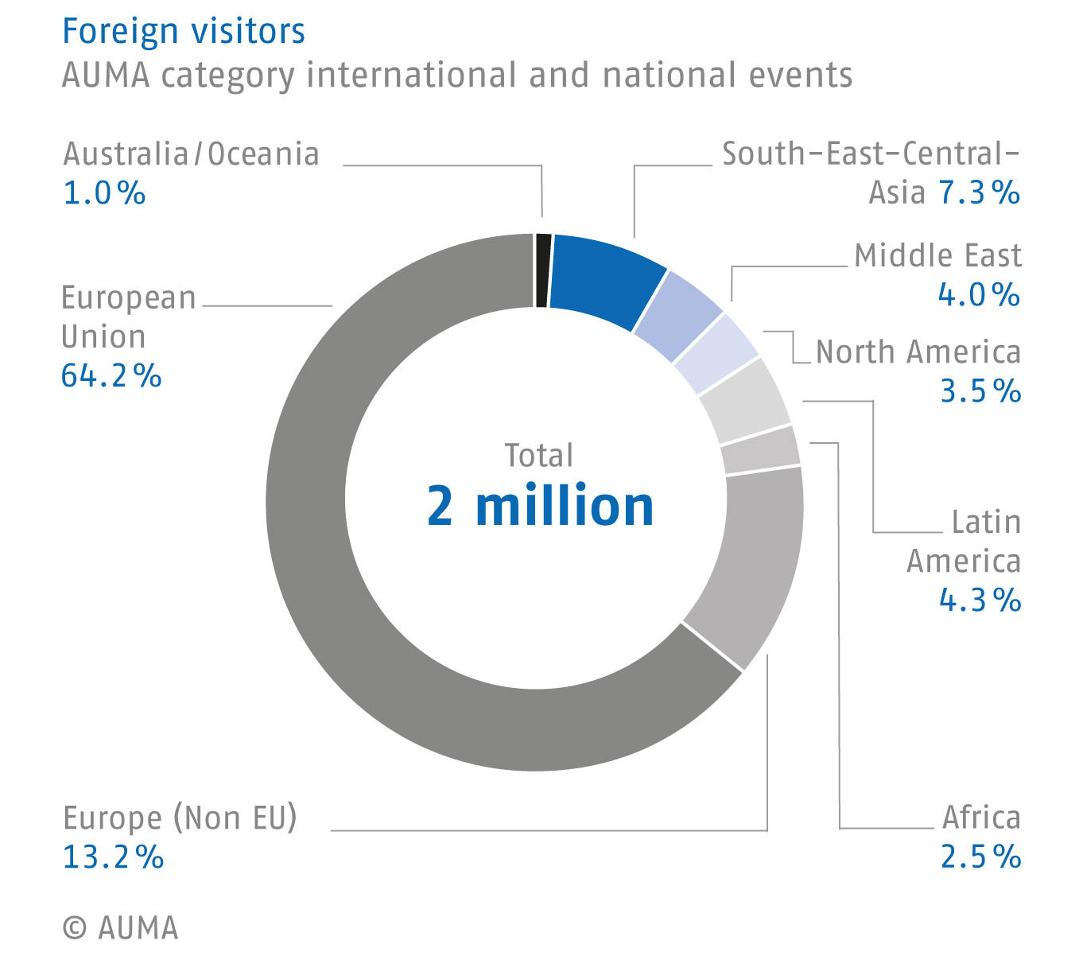
INTERNATIONAL EXHIBITORS
62%
…of the companies exhibiting at trade fairs in Germany come from abroad…
Source: AUMA trade fair database

Slide 9
origin of exhibiting companies 2019 - 2022 - 2023
Source: AUMA, exhibitors at German Trade Fairs

