Slide 1

Catalysing innovation – how meetings and exhibitions drive R&D, entrepreneurship, collaboration and growth
Moderator: Barbara Weizsäcker
Speakers: Inge Buffolo – Prof. Elizabeth Macintyre – Jean-David Malo – Jaume Puig
Notes:
Cover

Slide 2
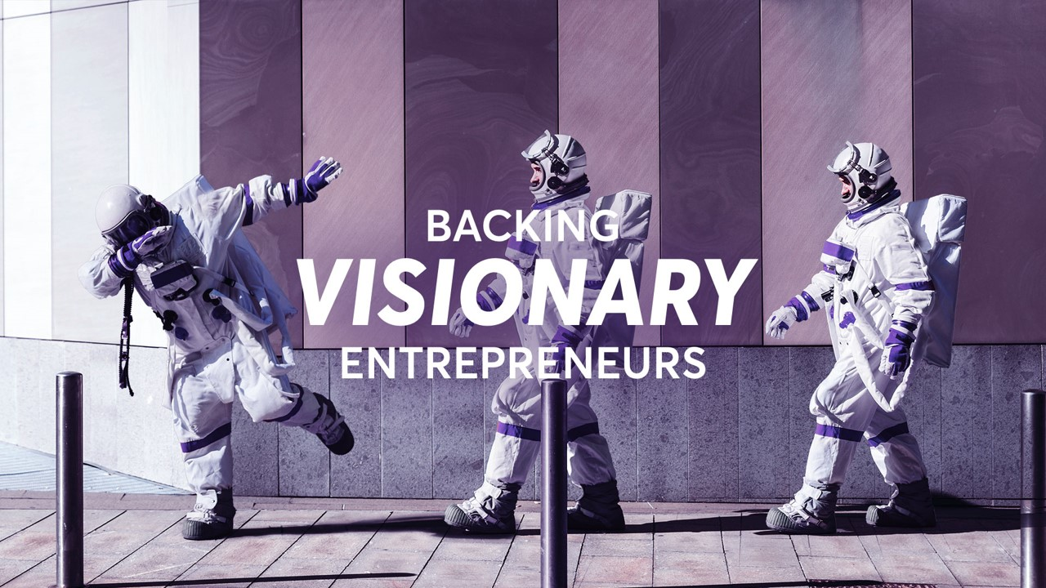


AND RESEARCHERS

Slide 3
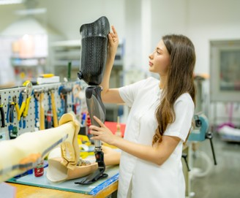
CROWDING IN INVESTMENT
Over €1bn of investment mobilised for deep tech investment under Horizon Europe
280 unique co-investors
Leverage effect of €3.5 of co-investment for every € invested via the EIC Fund
Wider portfolio attracting over €12bn of follow-on investment
>150 companies achieving Centaur valuation or above
SUPPORTING CRITICAL TECHNOLOGIES
> €500m for projects and companies developing or integrating developments in Artificial Intelligence
~ €350m in support of Biotechnology and Biomanufacturing in areas ranging from Industrial Biotechnology to Healthcare Biotech.
~ €500m in support of Chips Act through funding for Quantum Technologies and Semiconductors.
>150 projects with a clear focus on the development and use of Advanced Materials
EIC
IMPACTS
(from Impact Report 2023)
SUPPORTING STARTUPS & SMEs
Companies in receipt of support see employment growth of 35% and 65% revenue growth in the 2 years following EIC support
> 500 companies supported under the Accelerator since 2021
19% female CEOs amongst Accelerator beneficiaries
>100 companies have received investment and a total of > 200 have received investment decisions following due diligence
PIPELINE OF TECHNOLOGY BREAKTHROUGHS
> 300 early-stage research projects with Challenge based portfolios in areas such as energy storage, cell & gene therapies
~1700 unique innovations emerging from wider portfolio
140 projects commercialising research results with 50% originating from the ERC

Slide 4
@EUeic
#Eueic

Slide 5


Slide 6
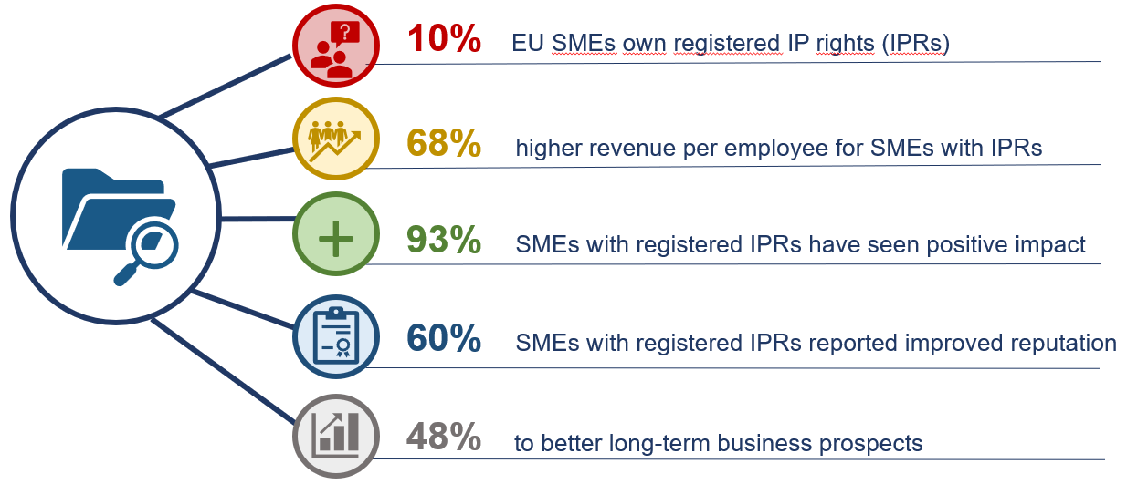
EU SMEs and IPRs - facts
2021 EUIPO and EPO joint study on Intellectual property rights and firm performance in the European Union
2022 EUIPO IP SME Scoreboard
Notes:
The primary, well-known function of an IP right is to give its holder a competitive advantage in its commercial activities, by preventing unauthorised exploitation by thirds. This is especially important for SMEs, which IP rights provide with powerful weapons to compete with much larger companies.
EXCLUSIVITY:
IP to avoid others entering the market, Condition: reliable high quality, innovative products/services. Strong market position and competitive advantage. Privileged position in the market: SMEs, startups.
PROTECTION:
Only legal protection against piracy/counterfeiting and imitators
Credibly threaten or take action against imitators and free-riders
REPUTATION:
positive image for your enterprise
IP is a tool for branding recognition, reputation and marketing
Even if you are not (yet) interested in the value of your business or brand but just want to sell your products, IP also works as a marketing tool. The ® symbol informs the public that the brand owner believes in the product and does not want competitors to ride on its reputation.
“Patent pending” or “patented” statements in marketing give a message about the product’s innovativeness.
By indicating that the appearance of the product is a protected design you make it clear that the product represents increasing individuality and stands out from the mass.
These messages appeal to customers and investors
OPPORTUNITY:
IPRs give you the freedom to tread into the export business as well. IPRs are territorial, so you should protect your innovation and creation with IP in the territories you foreseen to operate.
With the help of IPRs you can use your designs and brands to market your products and services in foreign lands as well, thus improving your export prospects.
Protecting brand, innovation and design of the product with intellectual property rights in major markets creates a basis for scaling business quickly and extensively.
By protecting the brand name, design or your invention in important countries you can ensure that nobody else gets better rights to the name in those countries.
e-commerce marketplaces - e.g: Amazon gives priority to IPRs protected sellers: avoid infringements complaints and ensures added value products
IP portfolio attracts partners - protecting partners’ interests -> attracts higher quality partners
Creating bargaining power
You can use your intellectual property to create a business on your own, pitch it to investors and start a business.
Intellectual property represents an important financial and legal asset for companies, including startups.
IP based agreements: Licensing, Purchasing, Co-branding, Franchising
EXCHANGE:
cross licensing
mutual agreements
ACCESS TO FINANCE:
IP portfolio attracts Investors. Enhanced ability to acquire finance at reasonable rates of interest
Investors want some guarantees that the investment is secured and that they have a privileged position in the market. Intellectual property represents an important financial and legal asset for companies, including startups.
MONETISATION: SOURCE OF INCOME:
Enhance the market value of your business -> IP valuation
In return for 3rd parties using IP, IP owner receives royalties (patents, brands, …). Additional income from licensing or selling (assigning) IP
IP sales (one-off)
Higher profit or returns on investment
For investors, companies with solid intellectual property portfolio are attractive investment targets. As the product or service protected by IPR has exclusive rights.

Slide 7
Intellectual property rights at Exhibition Centers
Protection of inventions and innovations; exhibition centers often serve as platforms for showcasing new inventions and innovations
Brand protection; exhibition centers are opportunities for companies to promote their brands and establish their presence in the market
Design protection; exhibition centers are opportunities for companies to showcase their products, their unique visual attributes
Licensing and commercialization opportunities; exhibition centers often attract potential business partners, investors, and licensees
Enforcement and dispute resolution; in cases where IP rights are infringed upon, exhibitors can take legal action to enforce their rights
Notes:
IP protection at exhibition centers safeguards exhibitor’s creative works, innovations and brands. It encompasses varios forms of IPR, including patents, trademarks, designs, copyrights, trade secrets.
To name but a few:
Protection of inventions and innovations: Exhibition centers often serve as platforms for showcasing new inventions and innovations. Intellectual Property rights, play a crucial role in protecting these inventions from unauthorized use or copying. Exhibitors can showcase their products and technologies, secure in the knowledge that their IP rights provide legal protection.
Brand protection: Trade fairs and exhibition centers are opportunities for companies to promote their brands and establish their presence in the market. Trademarks are essential for brand protection, as they distinguish goods or services from those of competitors. Exhibitors use trademarks to showcase their brand names, logos, and other identifying elements, ensuring their distinctiveness and preventing unauthorized use by others.
Licensing and commercialization opportunities: Trade fairs often attract potential business partners, investors, and licensees. Intellectual Property rights enable exhibitors to negotiate licensing agreements, allowing others to use their IP in exchange for royalties or other financial benefits. These agreements facilitate the commercialization and distribution of innovative products and technologies.
Enforcement and dispute resolution: In cases where IP rights are infringed upon during trade fairs, exhibitors can take legal action to enforce their rights. IP laws provide mechanisms for dispute resolution, including mediation, arbitration, or litigation, to address infringements, unauthorized copying, or other violations.
*(Other examples:.
Copyright protection: Copyright protects original creative works such as artistic, literary, and musical works. In trade fairs, copyright may apply to things like product designs, brochures, catalogs, marketing materials, and even software demonstrations. Exhibitors need to ensure that their copyright-protected works are not infringed upon by others.
Trade secret protection: Trade secrets encompass confidential business information that provides companies with a competitive advantage. In trade fairs, companies may showcase products or technologies that rely on trade secrets, such as manufacturing processes, formulas, or undisclosed features. Intellectual Property laws and agreements help exhibitors protect their trade secrets from unauthorized disclosure or use by competitors)

Slide 8

IP protection at exhibition centers safeguards exhibitor’s creative works, it promotes fair competition and stimulates economic growth
EUIPO can support:
with trustworthy information on intellectual property
expand services and information offered to exhibitors
enable exhibitors to showcase their IP assets with confidence
Notes:
We want to encourage you to take part in The New European Union Intellectual Property Office's Programme, which allows trade fair CEOs to fortify the reputation, reliability, and trustworthiness of their fairs, key elements needed to attract the participation of local entrepreneurship, promote regional identity, and foster local economic growth. This is crucial considering that in 2022 intellectual property-intensive industries in the EU accounted for approximately 47% of GDP (around €6.4 trillion) and 61 million jobs. The immense economic impact of IP protection within a specific region underscores the significance of creating an environment that empowers exhibitors to safeguard and leverage their Intellectual Property rights.
IP protection at exhibition centers safeguards exhibitor’s creative works, encourages innovation, supports brand recognition, attract partners, enables enforcement actions promotes fair competition stimulates economic growth
Showcase their IP assets with confidence

Slide 9


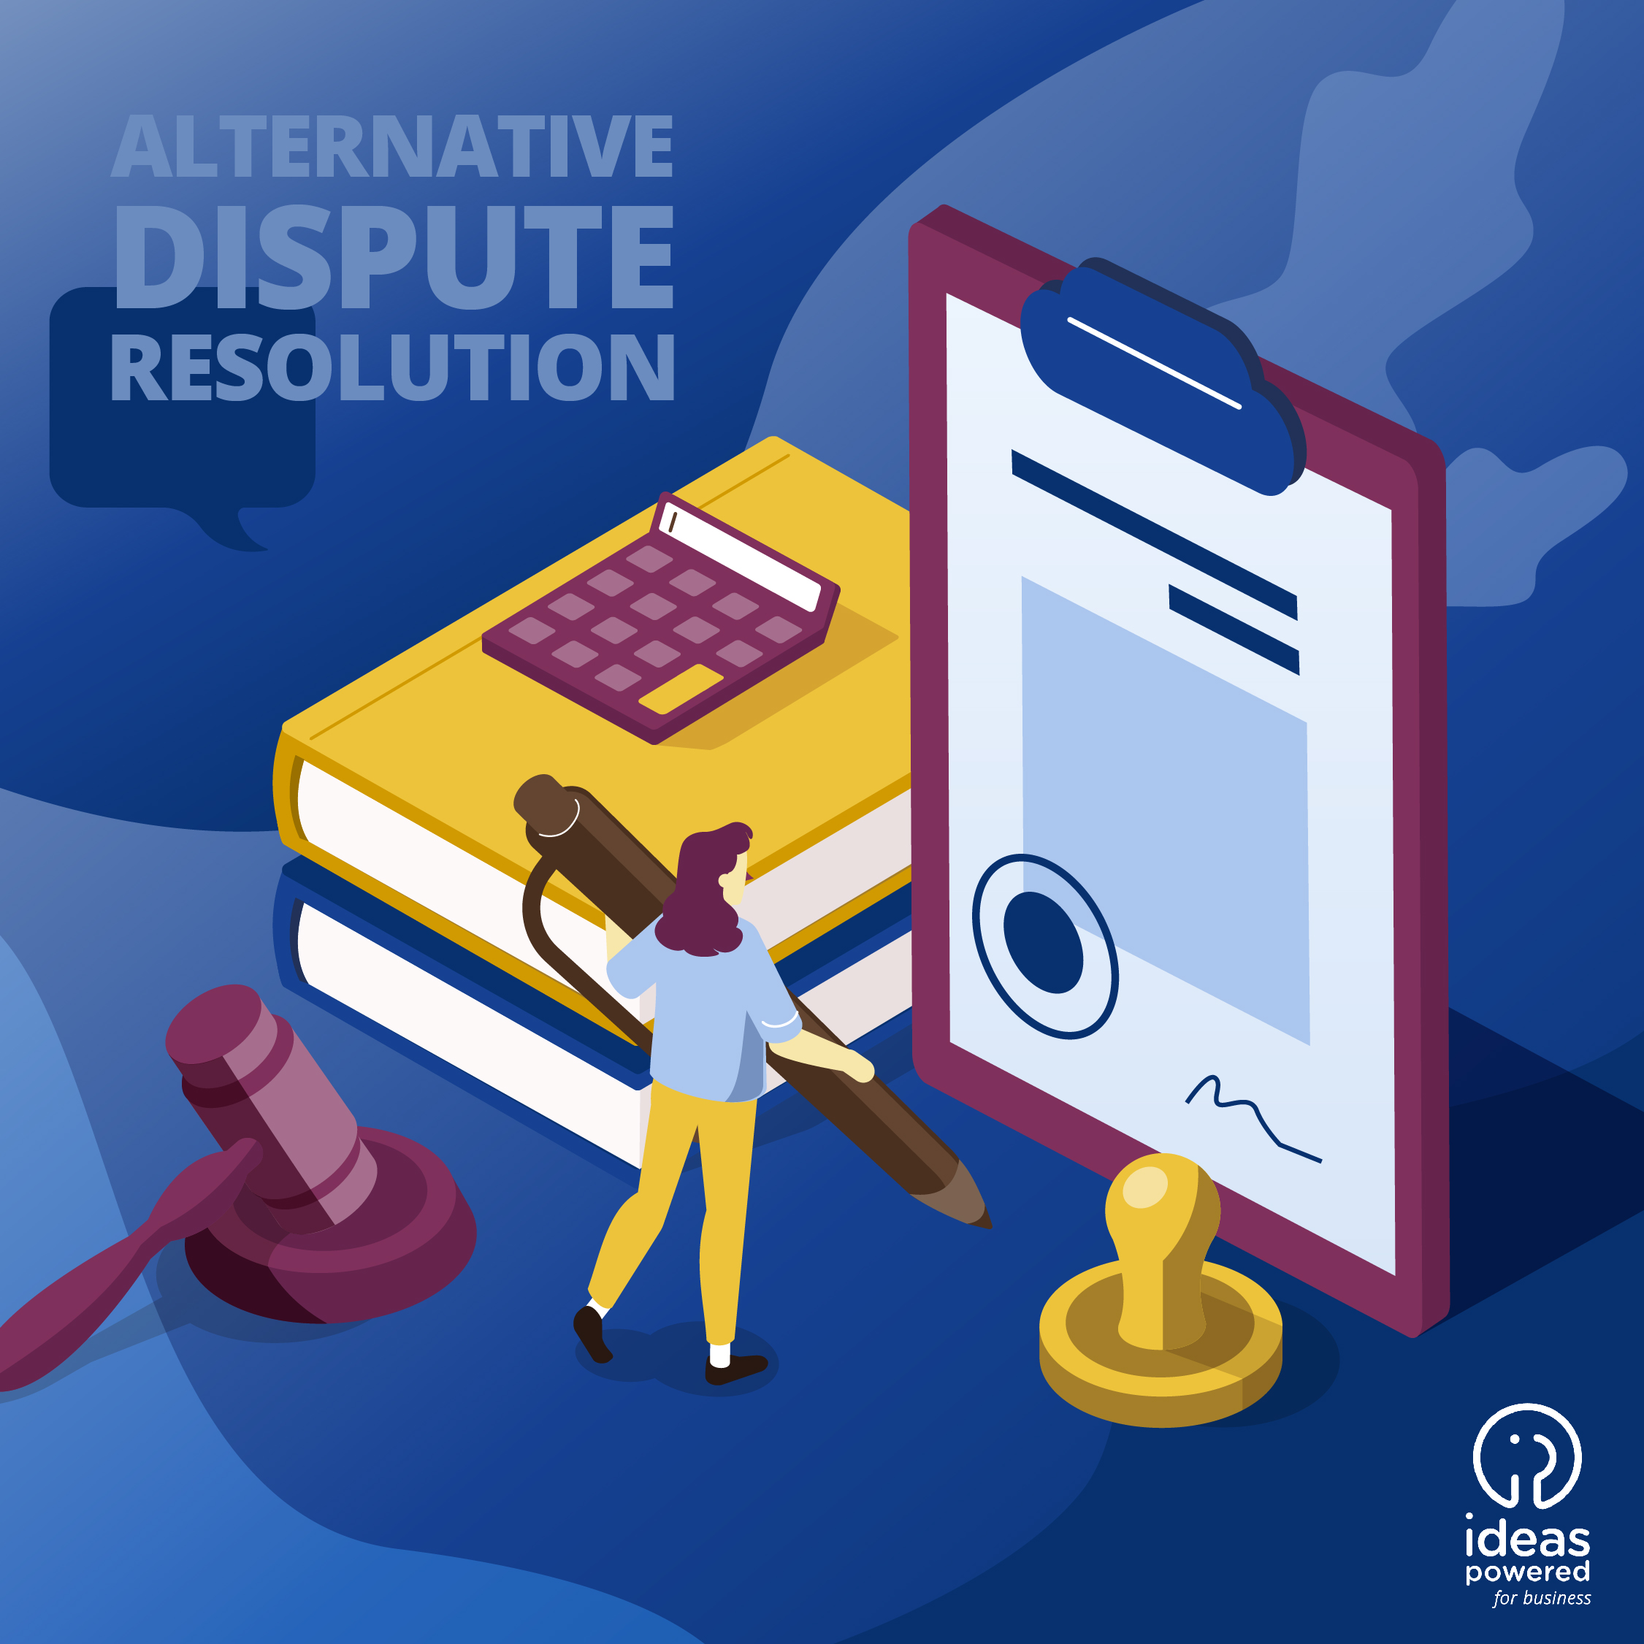

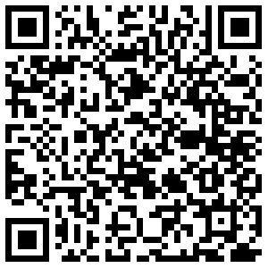
Ideas Powered for business Programme supportive initiatives
SME fund website
Notes:
The Ideas Powered for business SME Fund is a grant scheme designed to help EU SMEs protect their IP rights. It is a European Commission initiative implemented by the EUIPO which will run from 22 January 2024 to 6 December 2024.
Funds are limited and available on a first come, first served basis.

Slide 10
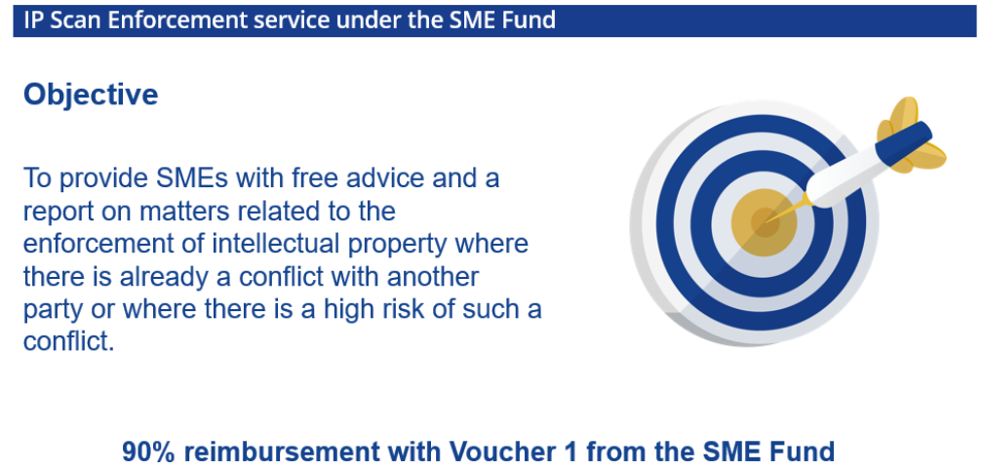
NEW

Slide 11


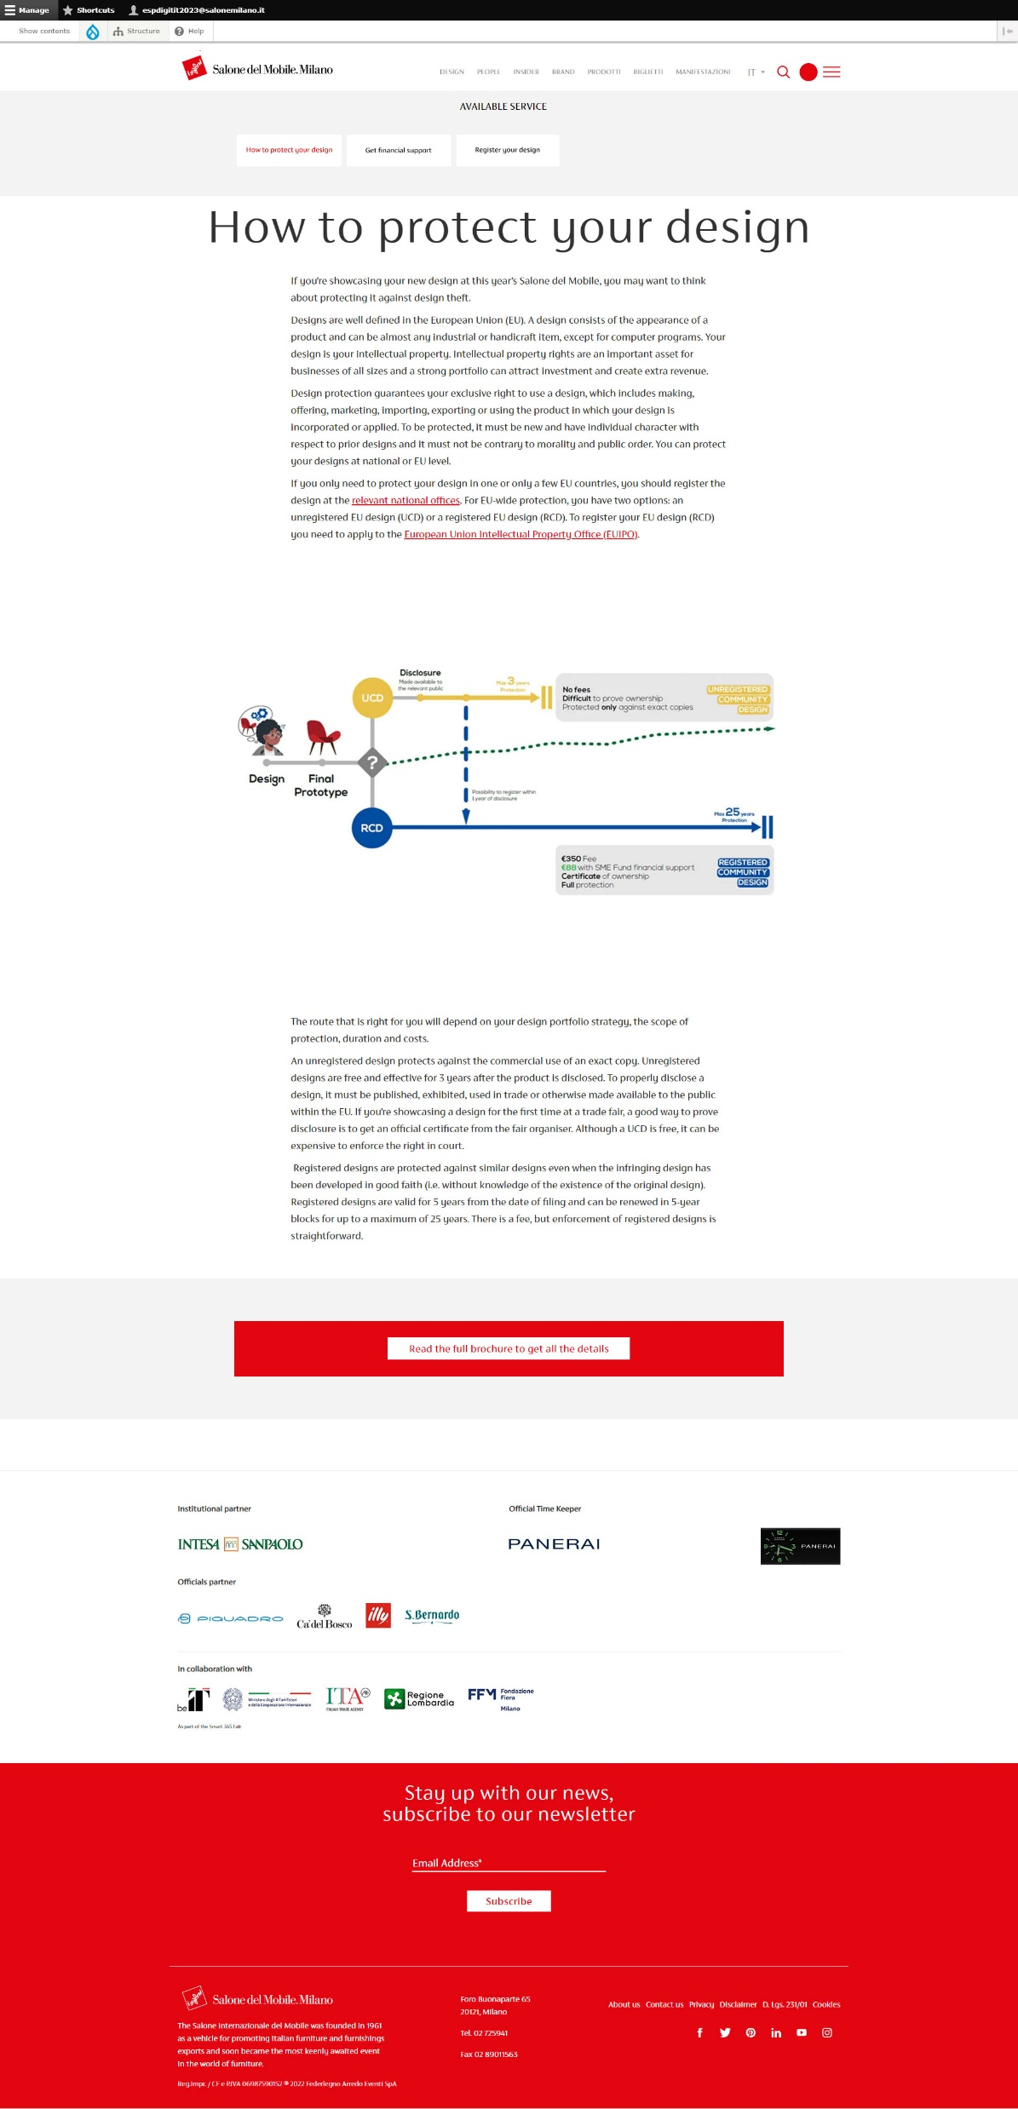

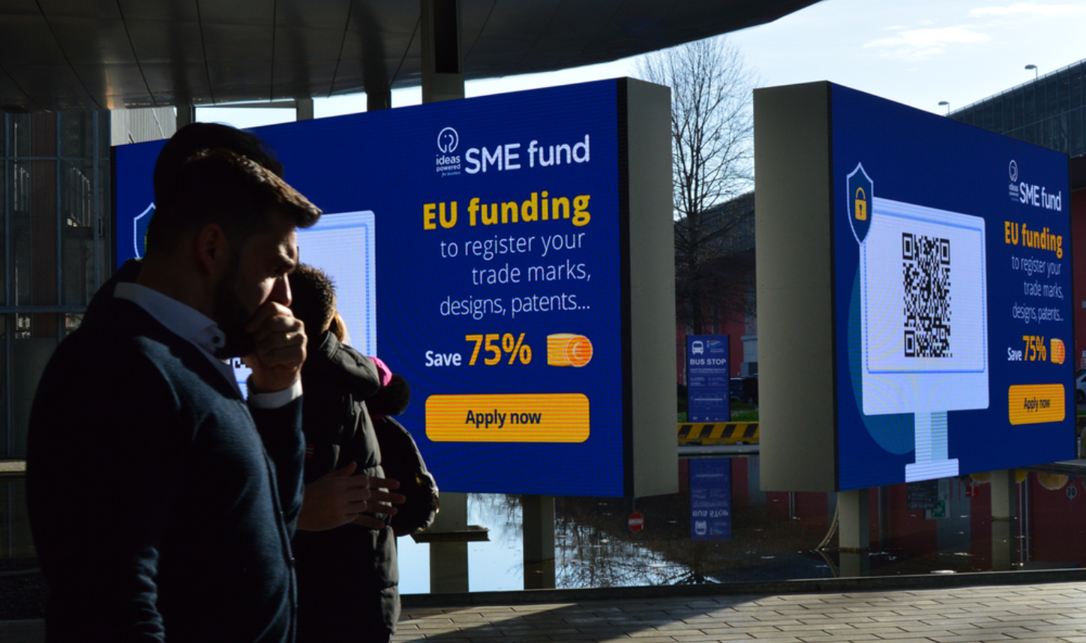
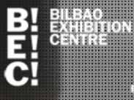

Pilot initiative with EMECA trade fairs organizations to support exhibitors
Notes:
Pilot with EMECA Members: Fiera Milano (IT), Fiera Rimini (IT), Fira Barcelona (ES) and Bilbao Exhibition Centre (ES)
Objective: to support exhibitors before trade fair events
Type of communication activities/materials: IP section implemented in trade fair’s website section for “exhibitors only”, video to promote SMEfund displayed on fair screens, direct mail campaign to exhibitors, newsletter articles, banners. Communication materials are implemented in national language and in EN
Methodology: Full collaboration with national IP Offices to implement communication activities
Activities implemented in Q1:
Fiera Rimini: “Vicenza Oro” trade fair (jewelry sector) - implementation of a dedicated IP section (Design) in fair organizer website + news article. 1300 exhibitors
Fiera Milano:
“Salone del Mobile (furniture) implementation of a dedicated IP section (Design) in fair organizer website + ad hoc mail campaign sent to exhibitors - 1300 exhibitors
MCE Beyond Comfort: video to promote SMEfund and Italian IP measures displayed in main Fiera Milano avenue (big screens) + newarticle shared to exhibitors – 1700 exhibitors.
Forecasted in 2024:
The Team is now replicating the approach with Fira Barcelona and Bilbao (2 fair events each)
Fiera Milano : Promotion of the SMEfund video in 10 trade fairs organized by Fiera Milano (in big screen) + news article for each event
Fiera Rimini: dedicated IP section to be implemented in a 2nd fair event (ECO mondo – on ecoinnovations)
Fira Barcelona “Hispack (Packaging) – May Exhibitors 720
Bilbao “Máquina-Herramienta y Fabricación Machinery” – 937
In total for ’24, we could estimate to have been able to implement 14 awareness raising initiatives to support up to 10.000 exhibitors.
In ’24, we would like to expand the pilot with 2 German fairs + 1 in Italy (Bologna) + 1 in Spain (Madrid / Valencia).
EUIPO aims to support tradefairs part of EMECA/UFI, creating synergies with national IP Offices

Slide 12
Thank you for your attention!
Ingrid Buffolo
Director at Customer Department in EUIPO
For info about the Ideas Powered for business Programme
ideaspoweredforbusiness@euipo.europa.eu
Notes:
Pilot with EMECA Members: Fiera Milano (IT), Fiera Rimini (IT), Fira Barcelona (ES) and Bilbao Exhibition Centre (ES)
Objective: to support exhibitors before trade fair events
Type of communication activities/materials: IP section implemented in trade fair’s website section for “exhibitors only”, video to promote SMEfund displayed on fair screens, direct mail campaign to exhibitors, newsletter articles, banners. Communication materials are implemented in national language and in EN
Methodology: Full collaboration with national IP Offices to implement communication activities
Activities implemented in Q1:
Fiera Rimini: “Vicenza Oro” trade fair (jewelry sector) - implementation of a dedicated IP section (Design) in fair organizer website + news article. 1300 exhibitors
Fiera Milano:
“Salone del Mobile (furniture) implementation of a dedicated IP section (Design) in fair organizer website + ad hoc mail campaign sent to exhibitors - 1300 exhibitors
MCE Beyond Comfort: video to promote SMEfund and Italian IP measures displayed in main Fiera Milano avenue (big screens) + newarticle shared to exhibitors – 1700 exhibitors.
Forecasted in 2024:
The Team is now replicating the approach with Fira Barcelona and Bilbao (2 fair events each)
Fiera Milano : Promotion of the SMEfund video in 10 trade fairs organized by Fiera Milano (in big screen) + news article for each event
Fiera Rimini: dedicated IP section to be implemented in a 2nd fair event (ECO mondo – on ecoinnovations)
Fira Barcelona “Hispack (Packaging) – May Exhibitors 720
Bilbao “Máquina-Herramienta y Fabricación Machinery” – 937
In total for ’24, we could estimate to have been able to implement 14 awareness raising initiatives to support up to 10.000 exhibitors.
In ’24, we would like to expand the pilot with 2 German fairs + 1 in Italy (Bologna) + 1 in Spain (Madrid / Valencia).
EUIPO aims to support tradefairs part of EMECA/UFI, creating synergies with national IP Offices

